Slide 1
Irregular verbs dictionary
Kadraliev Sardar aka “Semyon Kalinin” Math20 Freshman

Slide 2
Role Distribution
It was easy at the beginning, but in the middle of the project we realized, that some of us should take a rest for a while. The issue was because of lack of group participants, so, no one had worked on the project till my return.
Because of the meager knowledge in Phyton programming, it was insane to create something significant as a project.
Me, myself and I decided to divide roles properly. I was responsible for the phyton file, myself and me were responsible for presentation.

Slide 3
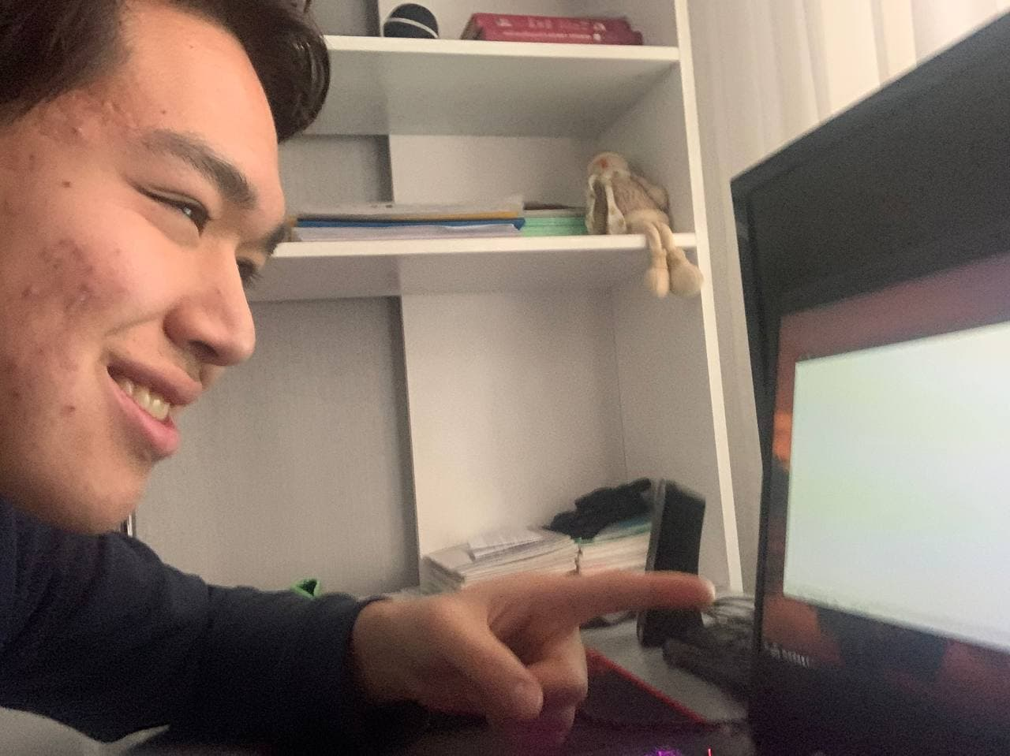
Planning
The project was planned long ago. Even I was In the middle school I dreamed about the dictionary, that represents all form of irregular verbs.
Planning had been finished when we finally found out what exactly we want to create.
It took about 2 days to figure out.

Slide 4
Analyzing
No time for Analyzes
Time to start working

Slide 5
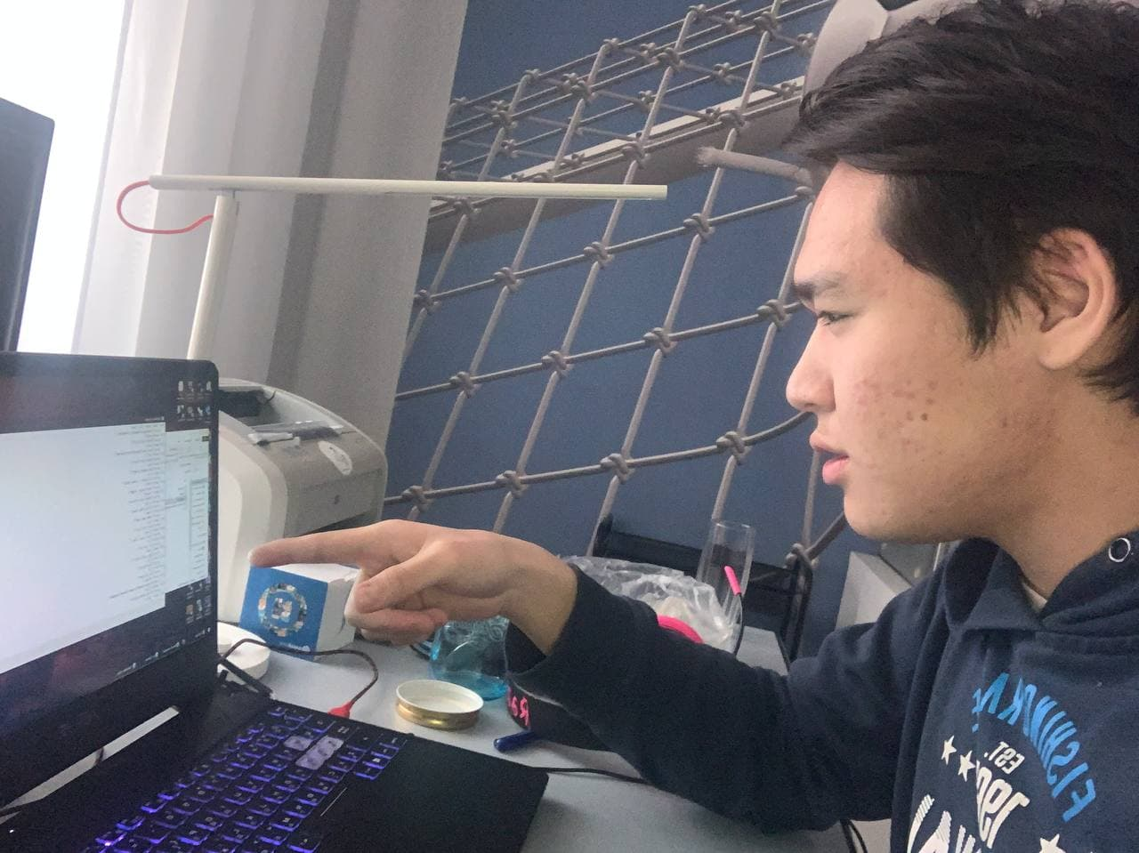
Design
Minimalism and strict style were our slogans for project.
Nothing extra but only momentous.

Slide 6
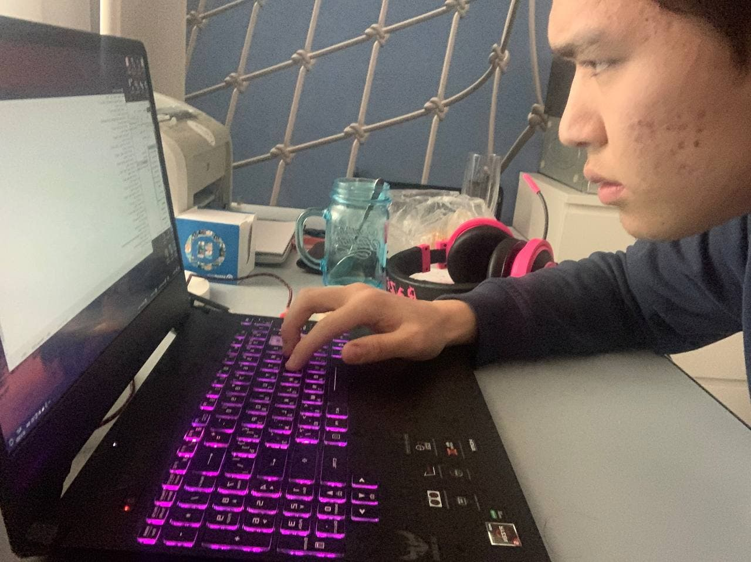
Implementation-coding
Because of the deadline our group have done our best to share the best version of the program
Coding took about 20 days of insane work

Slide 7
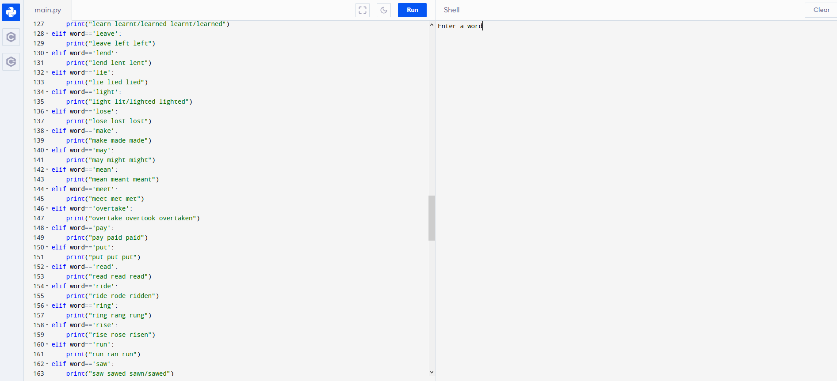
Testing
We finally checked all the cases that could occur when using the program.
“Irregular verbs dictionary” is still in beta-test.
No comments.

Slide 8

Meeting Schedule
The schedule was planned in advance.
Everyday meeting led us to success

Slide 9
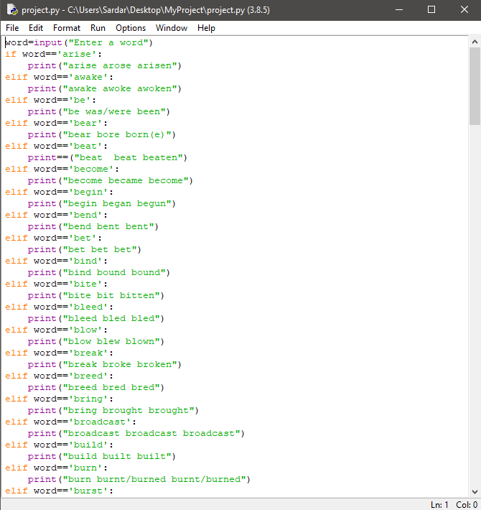
We recommend to check it out!

Slide 10
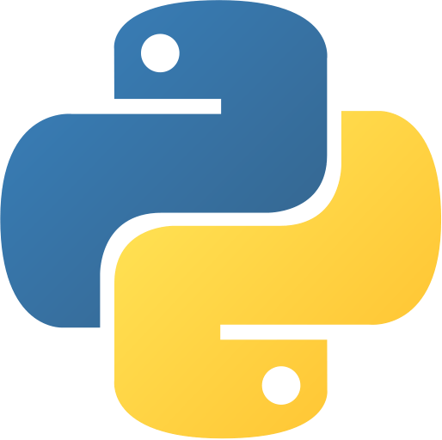
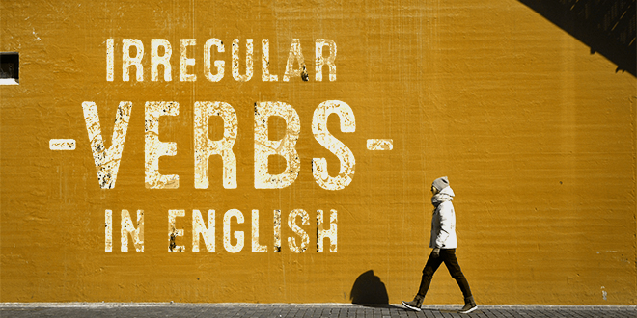
Thanks for attention

